Slide 1
Data Flow graphs and languages
The primary goal of using high level language in data flow computers is to take advantage of implicit parallelism.
An efficient data flow language should be able to express parallelism in a program more naturally, to promote programming productivity, and to facilitate close interactions between algorithm constructs and hardware structures.
Examples of data flow languages
include the Irvine Data- flow language (ID) and Value Arithmetic Language (VAL).

Slide 2
properties of data flow
Some of the properties of data flow languages are
Freedom from side effects based on functional programming .
Locality of effect without far-reaching data dependencies
Equivalence of instruction-sequencing constraints with data dependencies .
Satisfying single-assignment rule with aliasing
Unfolding of iterative computations into parallelism .
Lack of “history sensitivity" in procedures calls

Slide 3
Example 10.1

Slide 4
data flow graph
A data flow graph is a directed graph.
A data flow graph is used to represent dataflow languages.
Here nodes represent operations and arc are pointers for forwarding data tokens.
Some of the operators and links used in data flow languages are given below
Figure 10.7

Slide 5
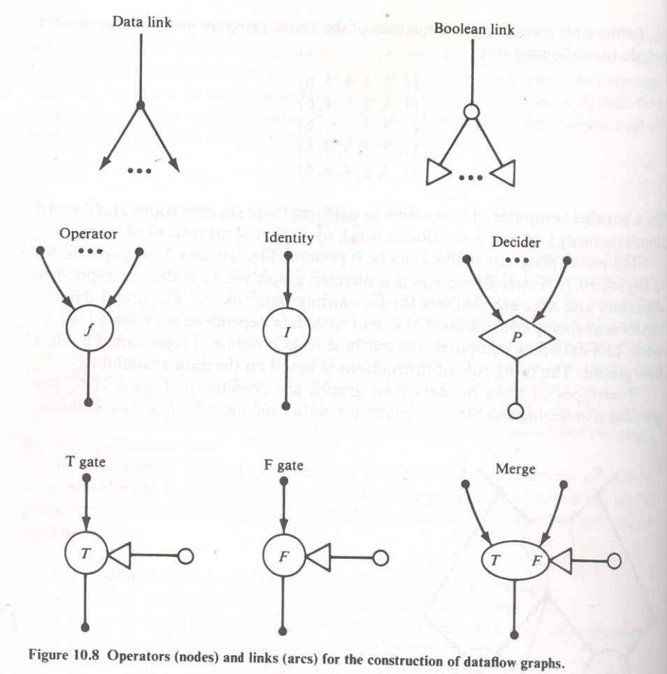

Slide 6
two types of links on data flow graphs:
  Data link
  Boolean link
  Numerical data links transmit integer, real or complex numbers.
  Boolean links carry only boolean values for control purposes.
  An identity operator is a special operator that has one input arc and transmits its input value unchanged.
  Deciders, gates and merge operators are used to represent conditional or iterative computation in data flow graphs.
  A decider requires a value from each input arc and produces the truth value resulting from applying the predicate P to the values received.

Slide 7
control tokens bearing boolean values control the flow of data tokens by means of T gates, F gates, and merge operators.
a T gate passes a data token from its data input arc to its output arc when it receives the true value on its control input arc.
a merge operator has T and F data input arcs and a truth-value control arc.
  When a truth value is received, the merge actor places the token from the true input arc on its output arc.
  The false input is passed to the output when the control arc is false.

Slide 8
properties of data flow languages
Locality of effect: this property is achieved if instructions have no unnecessary far-reaching data dependencies.
Global assignments and common variables should be avoided.

Slide 9
properties of data flow languages
Freedom from side effects: side effects in procedures modify variables in calling program.(1 problem)
Soln: Absence of Global assignments and common variables and careful control of scopes of variables can avoid side effects.
2nd problem comes from aliasing of parameters.
Soln: data flow languages provide ‘call by value’ instead of ‘ call by reference’.

Slide 10
properties of data flow languages
single-assignment rule: the rule is to forbid the use of same variable name more than once on the left hand side of any statement.
A new name is chosen for any redefined variable and all subsequent references are changed to the new name.
  X:=P-Q X:=P-Q
  X:=XxY -> X1:=XxY
  W:=X - Y W:=X1 - Y

Slide 11
properties of data flow languages
Unfolding iterations:
  Iterative computations are represented by ‘cyclic’ data flow graphs.
  In order to achieve parallel processing , iterative computations must be unfolded.
  Tagged tokens are used to unfold activities.
  The U-interpreter is used to unfold iterations.

